Slide 1
CSE 3666 Exam 1 Review
The exam will cover the topics from Lectures 1.1-1.9.

Slide 2
Numbers, bits, bytes, and ASCII characters
Binary numbers, two’s complement numbers, hexadecimal numbers.
Conversion between different number systems, including decimal numbers, binary, hexadecimal.
Signed and unsigned extension.
Addition/subtraction of binary/two’s complement numbers. Negate a two’s complement number.
Bitwise logical operations.
ASCII characters.

Slide 3

RISC-V ISA
Skill: Be extremely familiar with a set of core MIPS instructions, understand their operations, and use them properly.
RISC-V instructions sets. Arithmetic, logical, memory, control flow instructions.
Instruction class | RISC-V examples
Arithmetic | add, sub, addi…
Data transfer | lw, sw, lb, lbu, sb lh, lhu, lui…
Logical | and, or, xor, andi, ori, sll, sra…
Cond. Branch | beq, bne…
Jump | Jal, jalr…

Slide 4
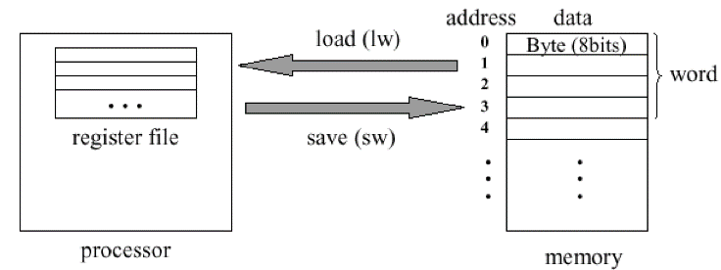
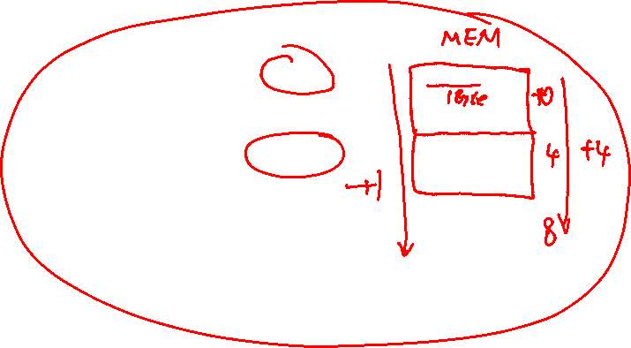
Data
Skill: Properly specify operands in instructions and access data in programs.
1. Accessing data in registers and memory.

Slide 5
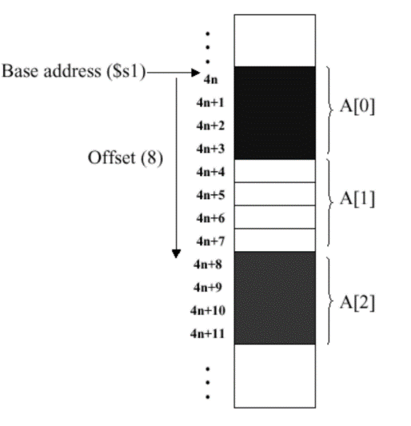
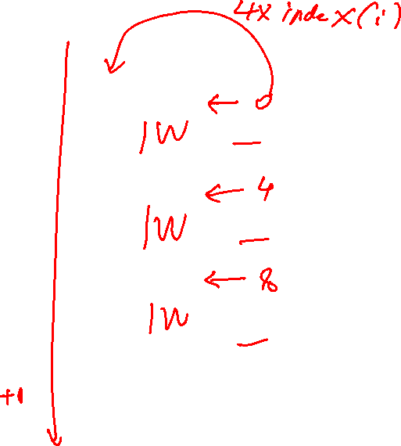
Array in memory. Array of words, half-words, and bytes (characters).

Slide 6
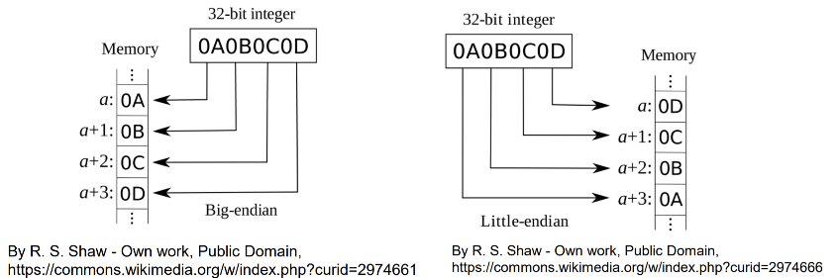
Data of different sizes. Sign extension. Endianness.

Slide 7




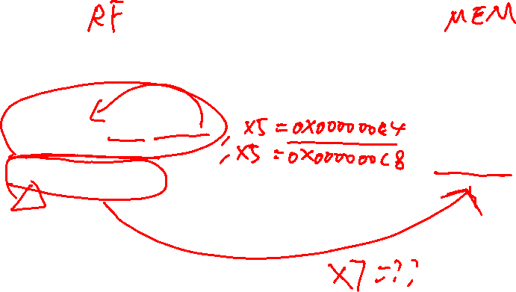



Address . . . . . . 0x000000C4 0x456A789B
0x000000C8 0xDB733A56
. . . . . .
addi x5, x0, 0x0C4 addi x5, x5, 4 lb x7, 0(x5)

Slide 8
Control flow
Skill: given enough information, encode MIPS instruction with 32 bits and understand encoded instructions.
Program counter.
RISC-V support for if-then-else, loops, functions.
Compare values with beq,bne, etc.
RISC-V calling convention. Caller-saved /callee-saved registers. Passing parameters to / returning value from functions.
Stack. Push/pop. Save/restore registers on stack. Allocate storage space on stack.

Slide 9
Stack operations
#push x1
addi sp, sp, -4
sw x1, 0(sp)
# pop x2
lw x2, 0(sp)
addi sp, sp, 4
Push
Pop
sp
sp
sp
sp
x2
x2
x2
x1
x1

Slide 10
push multiple words
Write RISC-V instructions to push s1, s2, and s3 onto the stack
Instead of 3 ADDI’s, we can adjust sp once for three words
# reserve space for 3 words
addi sp, sp, -12
sw x1, 8(sp)
sw x2, 4(sp)
sw x3, 0(sp)
 | Address | Value
 | 0x7FFF 901C
 | 0x7FFF 9018
 | 0x7FFF 9014
 | 0x7FFF 9010
 | 0x7FFF 900C
 | 0x7FFF 9008
 | 0x7FFF 9004
 | 0x7FFF 9000
Before push
sp
x1
x1
x2
x2
x3
x3
sp

Slide 11
push multiple words
Write RISC-V instructions to push s1, s2, and s3 onto the stack
Instead of 3 ADDI’s, we can adjust sp once for three words
# pop x1, x2, and x3
lw x1, 8(sp)
lw x2, 4(sp)
lw x3, 0(sp)
addi sp, sp, 12
 | Address | Value
 | 0x7FFF 901C
 | 0x7FFF 9018
 | 0x7FFF 9014
 | 0x7FFF 9010
 | 0x7FFF 900C
 | 0x7FFF 9008
 | 0x7FFF 9004
 | 0x7FFF 9000
x1
x1
x2
x2
sp
x3
x3
Before pop sp

Slide 12
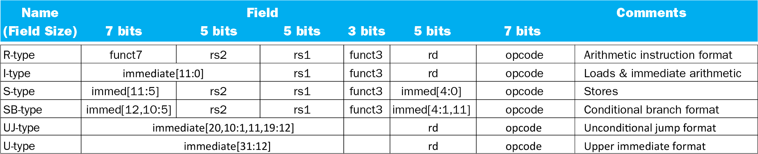
Instruction Encoding
Six instruction formats.

Slide 13
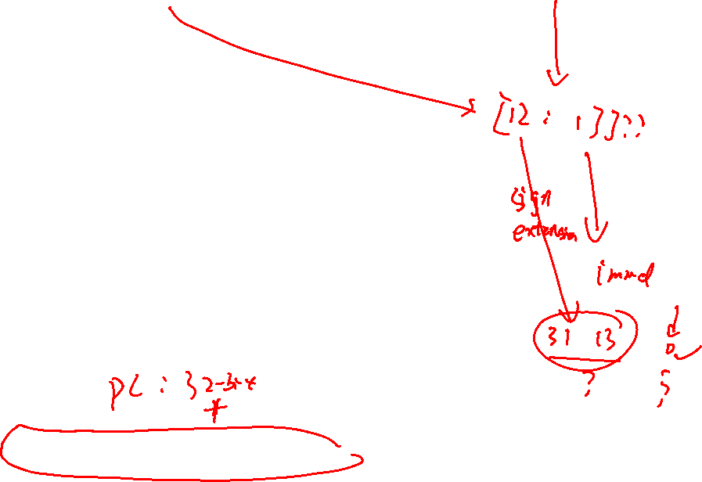
Bne x10, x11, 200
imm
rs2
rs1
funct3
imm
opcode
7 bits
5 bits
5 bits
3 bits
5 bits
7 bits
Instr is the 32-bit machine code.
imm == offset
Opcode=1100011; funct3=001;
Instr[31:25] funct7=0 000110
Instr[11:7] rd= 01000
s
h
h
h
h
h
h
l
l
l
l
x
imm
ss…ss
s
x
h
h
h
h
h
h
l
l
l
l
0
31
12
11
10
5
4
1
0
imm[31:13] are s.
Sign extension!
imm[12:1] are Instr[31:25,11:7]
imm[0] is always 0
200= 0b 0000 0000 0000 0000 0000 0000 1100 1000

Slide 14




Assembly code
Translate pseudocode or simple C code to RISC-V assembly code.
Understand/debug RISC-V code.

